Slide 1
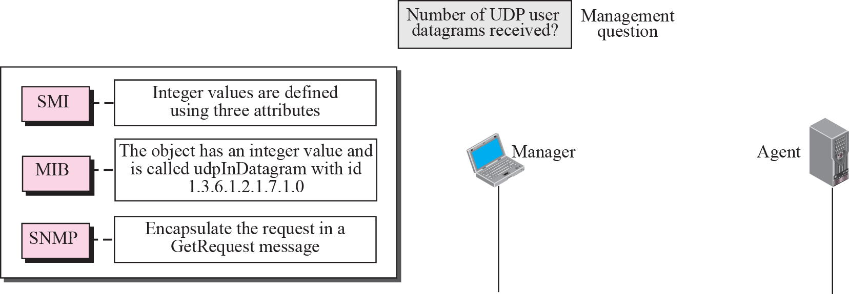

Figure 24.4 Management overview

Slide 2
24-3 SMI
The Structure of Management Information is a component for network management. Its functions are:
1. To name objects.
2. To define the type of data that can be stored in an object.
3. To show how to encode data for transmission over the network.
SMI is a guideline for SNMP. It emphasizes three attributes to handle an object: name, data type, and encoding method.

Slide 3
Topics Discussed in the Section
Name
Type
Encoding Method

Slide 4
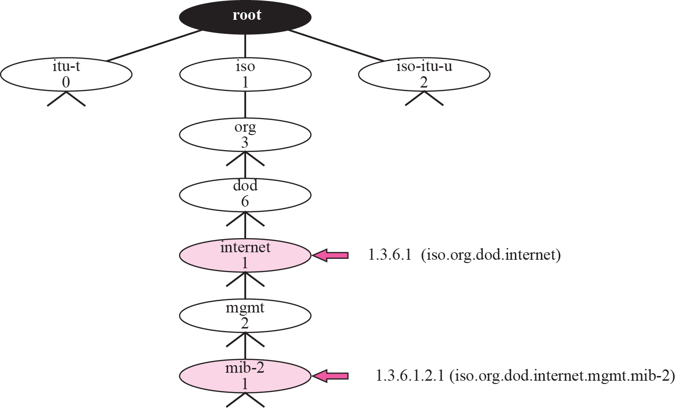
Figure 24.5 Object identifier

Slide 5

Note
All objects managed by SNMP are given an object identifier.
The object identifier always starts with 1.3.6.1.2.1.

Slide 7
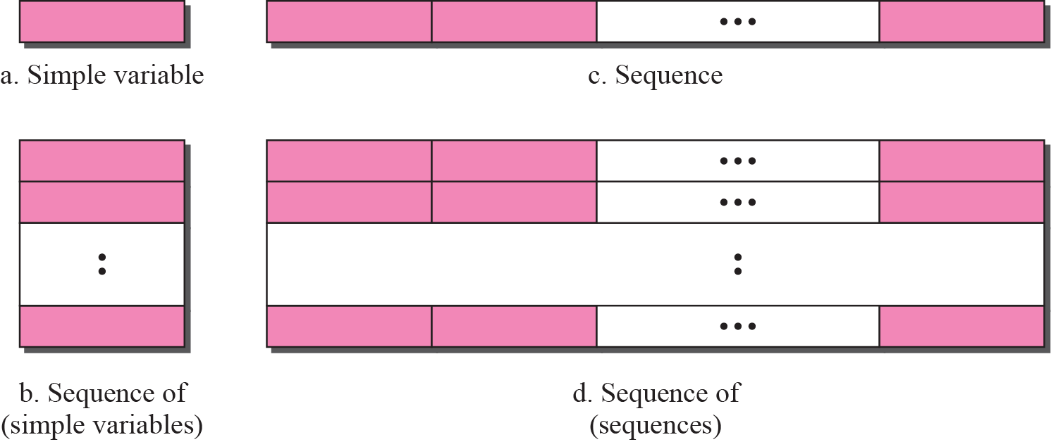
Figure 24.6 Conceptual data types

Slide 8
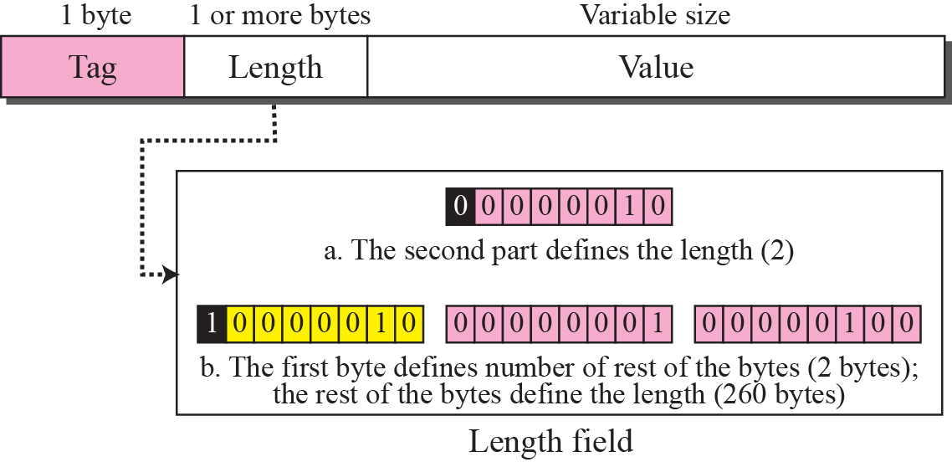
Figure 24.7 Encoding format

Slide 10
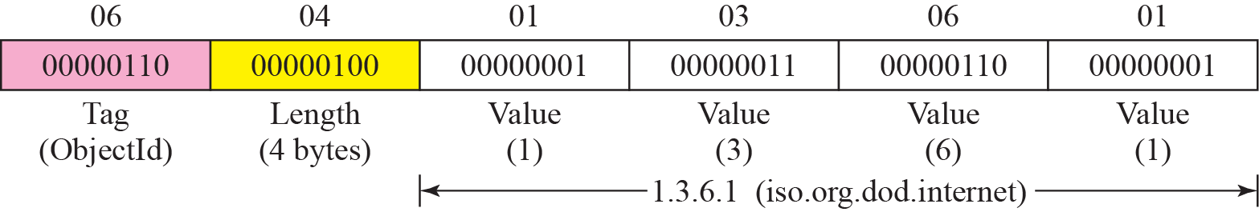
Figure 24.10 Example 24.3: ObjectIndentifier 1.3.6.1

Slide 11
Example 24.4
Figure 24.11 shows how to define IPAddress 131.21.14.8.

Slide 12
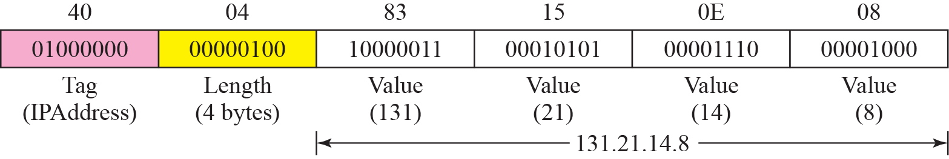
Figure 24.11 Example 24.4: IPAddress 131.21.14.8

